Slide 1
Plant Seedling classification
(Determine the species of a seedling from an image)
Team Members: (Team id-1)
Sai Harshavardhan Maddula (class Id: 15 )
Venkata Sri Rohita Goparaju (class Id: 27)
Divya Reddy Bandari (class Id: 7)
Sai Srinivas Vidiyala (class Id: 17)

Slide 2
Objective
Its’s hard to differentiate a weed from a crop seedling, the ability to do so will yield a better result in the crop yields.
It helpful for the farmers and bring the efficient work from them.
Then a research was started to build a model to differentiate the weeds.
Recently a dataset of 960 unique plants belonging to 12 species at several growth stages was released by the USD.
This challenge motivated us to build a model with different classification layers and recognition techniques and train with the dataset and test using a validation set.

Slide 3
Data Description
The purpose of this project is to create a classifier capable of determining a plant's species from a photo.
4750 labeled images (1.73GB)
12 different types plants
Test set -794 images(91MB)
All the images are quadratic but vary in size
Each image has a filename that is its unique id

Slide 4
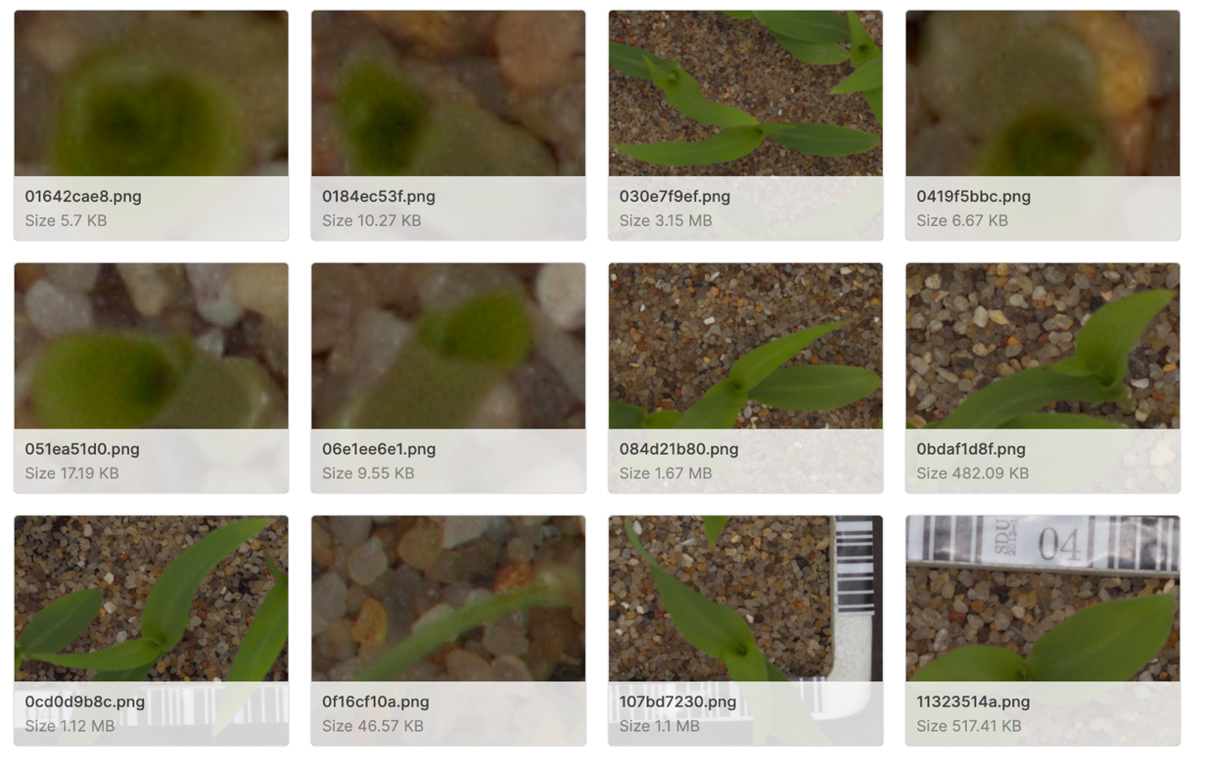
Different Species
12 Different Species
1. Black-grass 5. Common wheat 9. Scentless Mayweed
2. Charlock 6. Fat Hen 10. Shepherds Purse
3. Cleavers 7. Loose Silky-bent 11. Small-flowered Cranesbill
4. Common Chickweed 8. Maize 12. Sugar beet

Slide 5
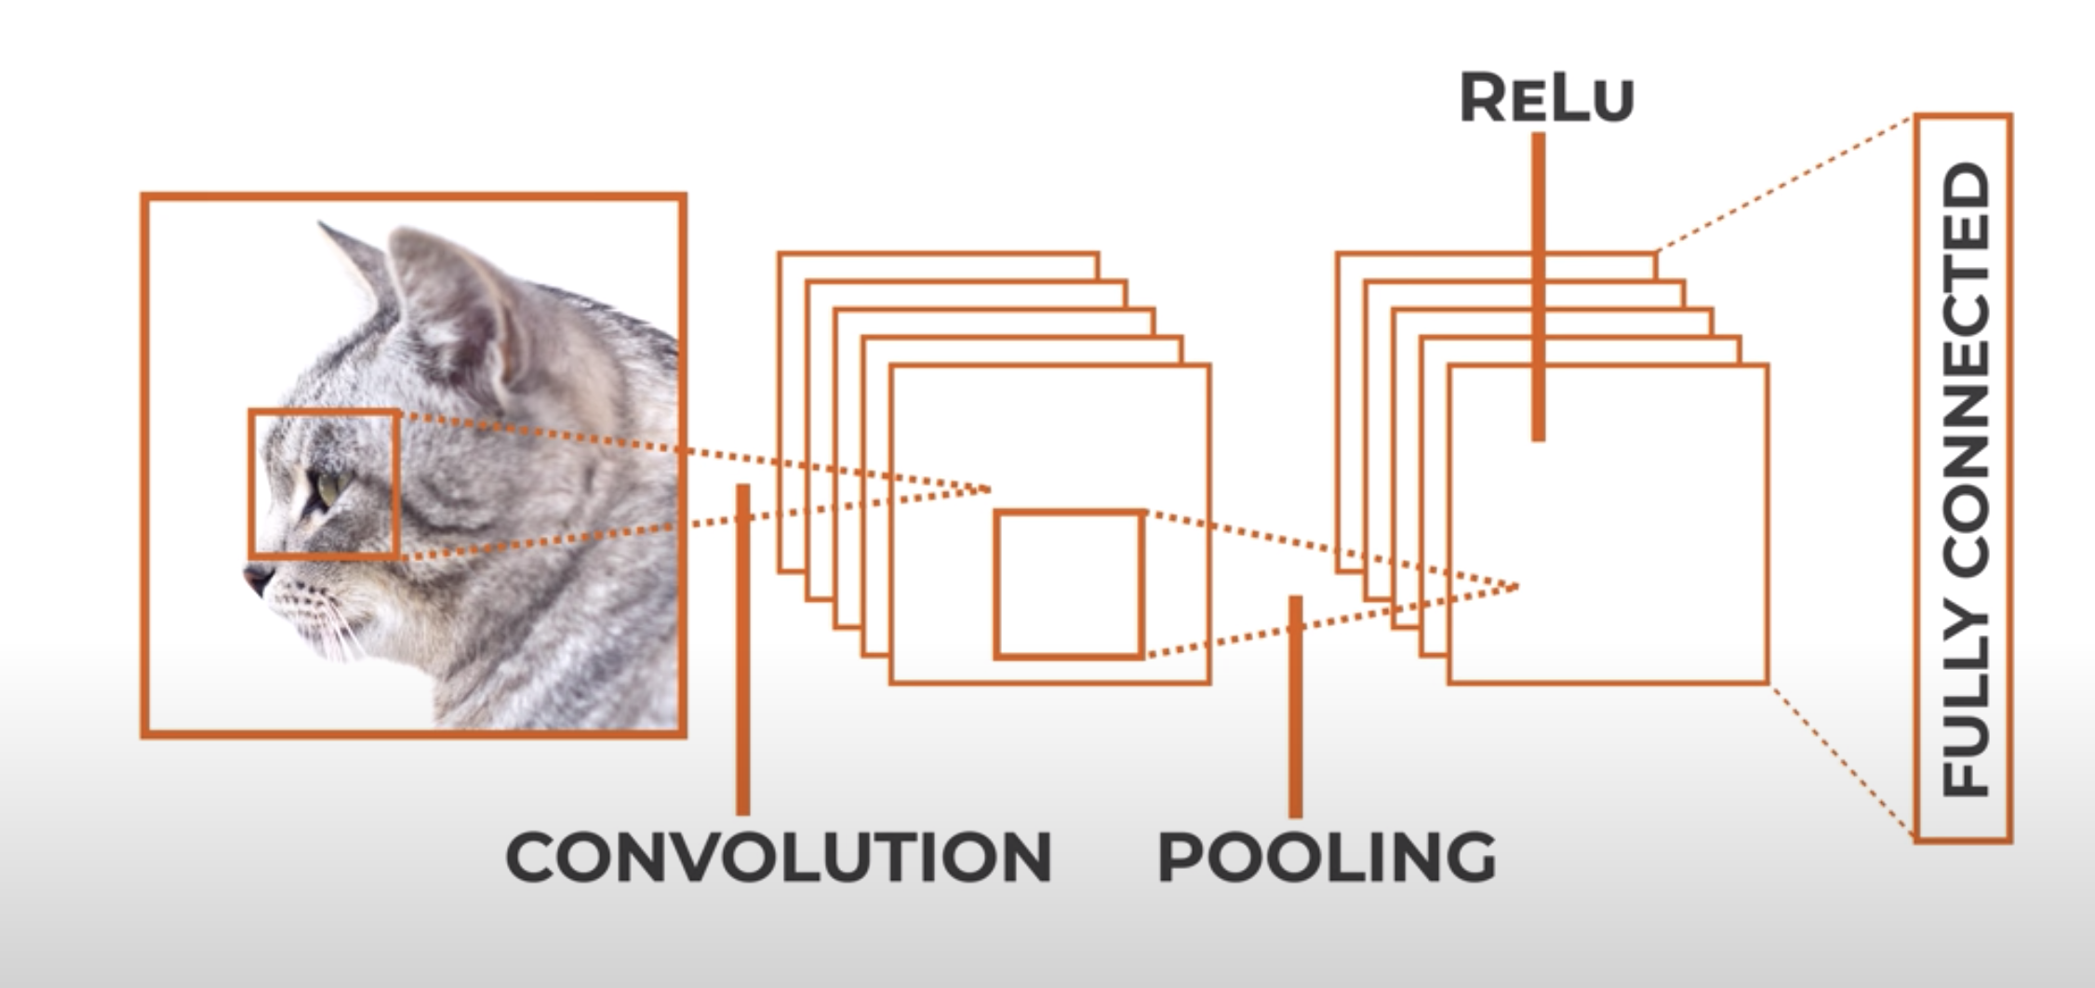
Approach
We are using the CNN Approach for differentiating the weed from the crop seedling.
CNN is a feed forward neural network that is generally used for Image recognition & object classification which helps to get our final result of Image processing.
CNNs represent a huge breakthrough in image recognition, used to analyze visual imagery and are frequently working behind the scenes in image classification.
Since our focus is on Image classification and Deep Learning techniques, and to get accurate results out of it we have chosen this approach.
Input ->Convolution ->Relu ->Convolution ->Relu ->Pooling ->Relu ->Convolution ->Relu ->Pooling ->Fully Connected

Slide 6





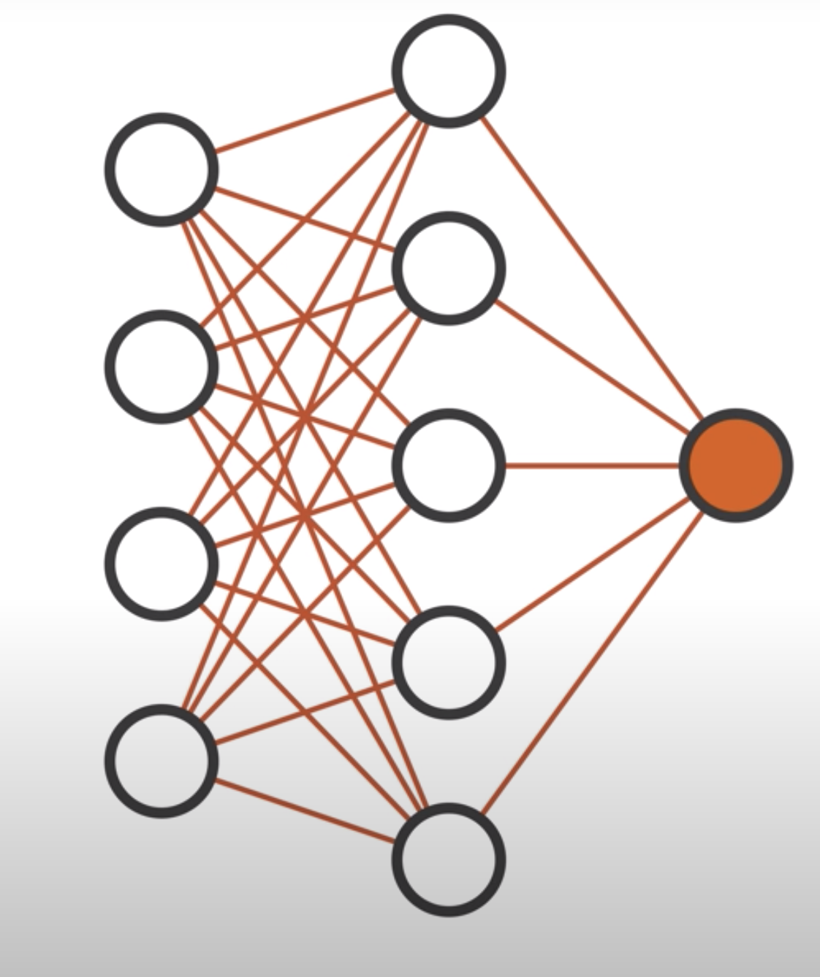
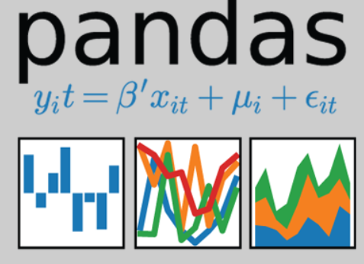

Technical Stack:
Pycharm
Python 3.8
cv2
glob
numpy
matplotlib
math
Pandas
CNN

Slide 7

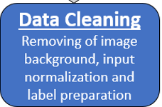
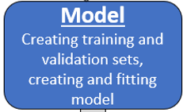
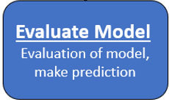
System Architecture

Slide 8
Overall Architecture
Data Extraction
Cleaning Data
Model
Evaluate model
visualization in dashboard
Masking Green Plant
Split Dataset
Load Model From File
Normalize input
Data Generator
Confusion Matrix
Categories labels
Create Model
Get Results
Fit model

Slide 9
Solutions available
ANN(By using Artificial Neural Networks):
Challenges:
Losing the spatial features of an image (arrangement of pixels)
Failed to capture the sequential information in the data.
To over come these CNN was built.
CNN(By Using Convolutional Neural Networks)

Slide 10
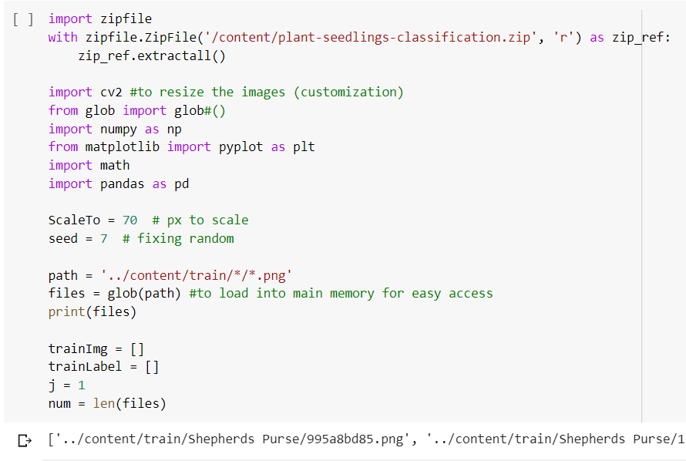
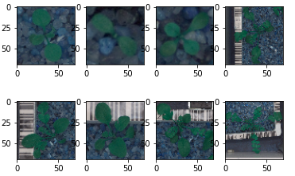
Data Extraction
Collecting the images.
Resizing to 70 x 70 px.
For quicker training of model we use 70 X 70 px.

Slide 11
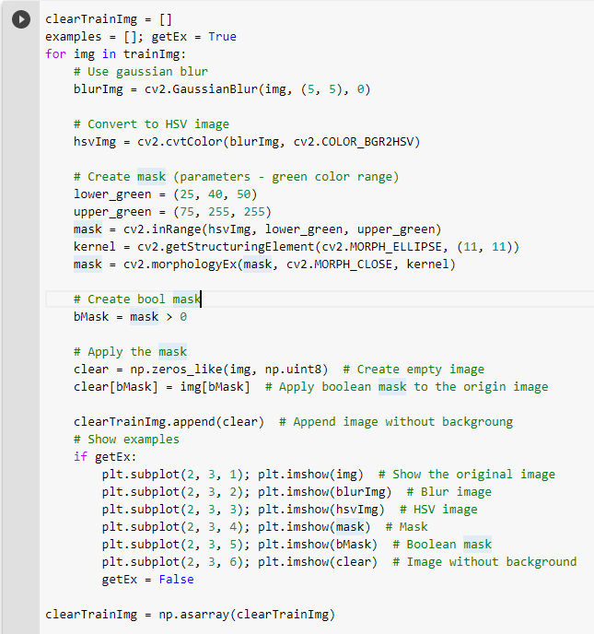
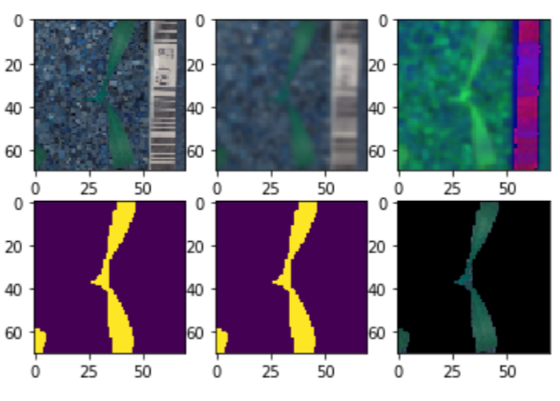
Cleaning Data
Here we have created a mask to remove the other parts of the images and leave some range of green color.
Results:

Slide 12
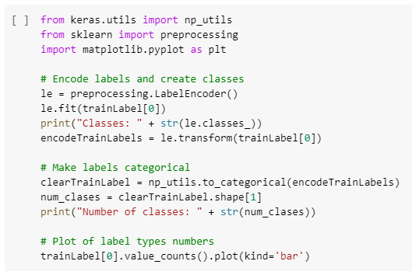
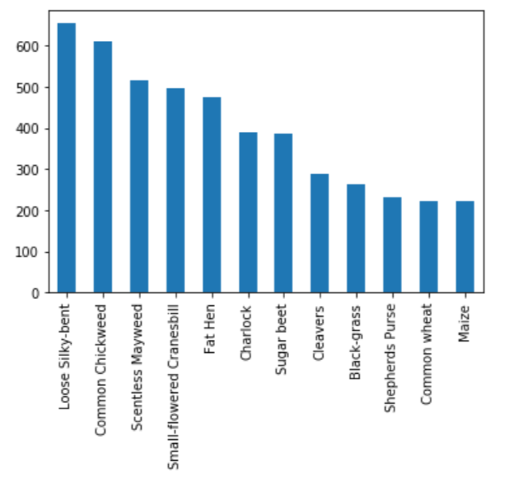
Preprocessing Steps
Encoding the image labels where they are 12 String names, creating classes array and encoding every label by its position in this array.

Slide 13
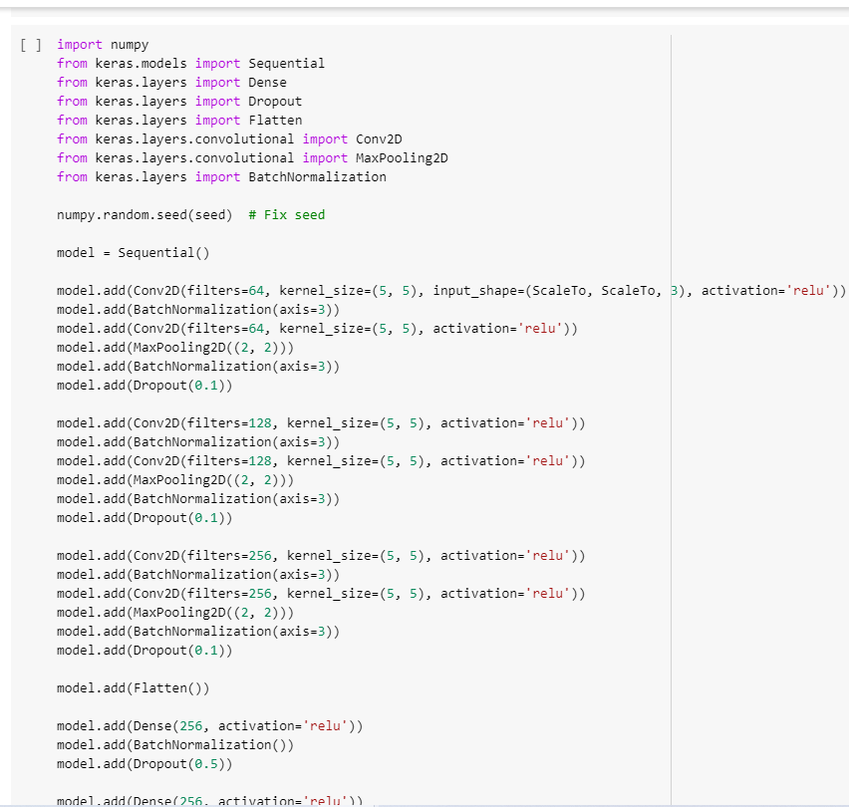
Model Creation
We have used sequential model with CNN hidden layers.
We have built three convolution layers which caused over fitting . So in the final increment we reduced them and changed number of neurons in the hidden layer to build an efficient model

Slide 14
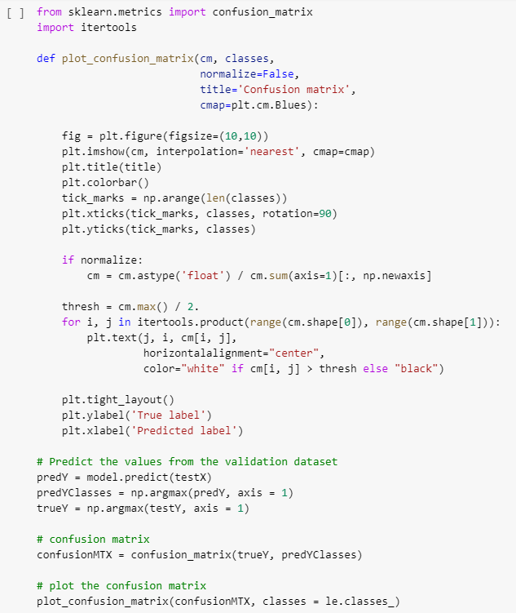
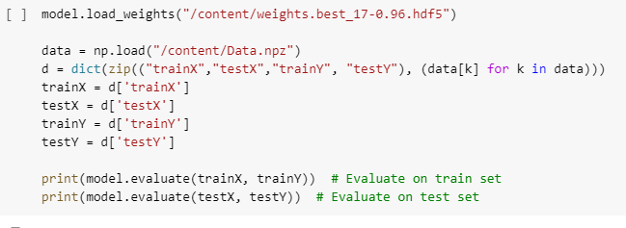
Evaluation Model
Confusion matrix
Load model from file

Slide 15
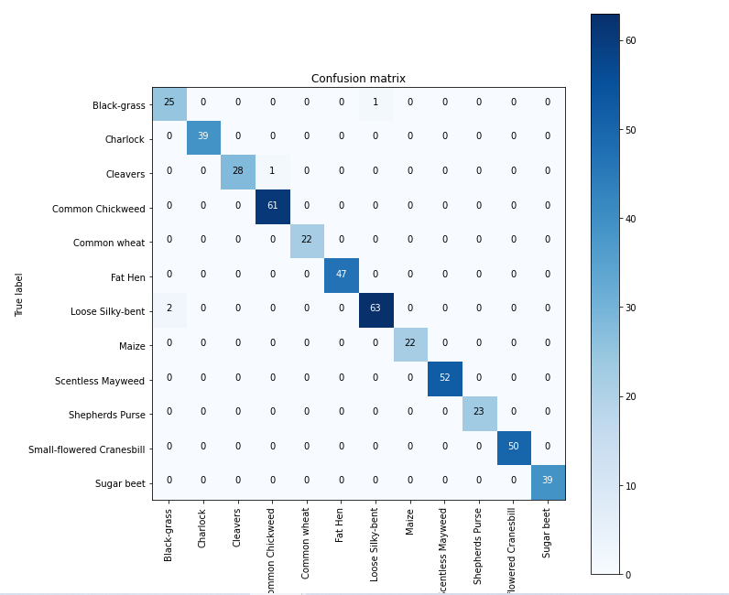
Confusion Matrix
The number of correct and incorrect predictions are summarized with count values and broken down by each class. This is the key to the confusion matrix.
This gives you insight not only into the errors being made by your classifier but more importantly the types of errors that are being made.

Slide 16
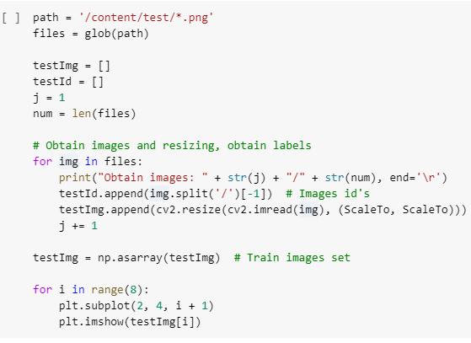
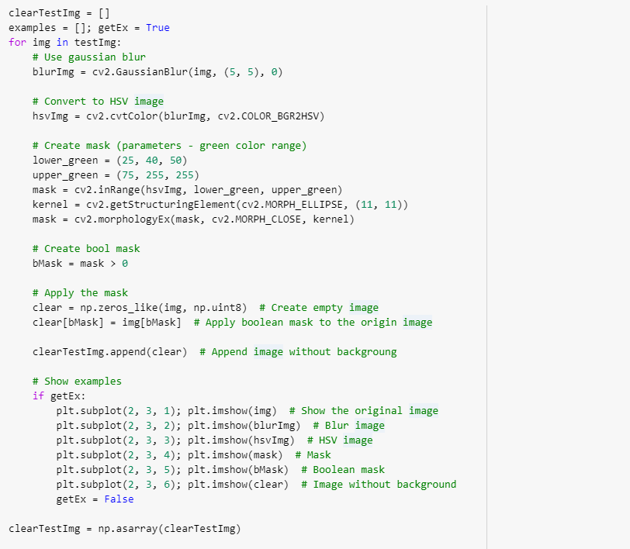
Get Results
Set of validation images are used for the evaluation model accuracy.
We have loaded these images from the directory and cleared the background and feed to the model.
The model successfully evaluates and produce a CSV file with all the results with categories.

Slide 17
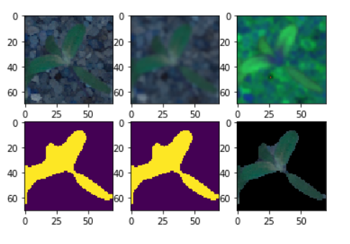
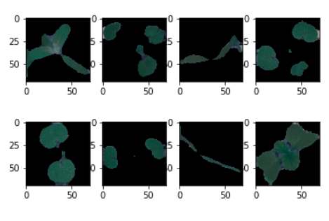
Test Results

Slide 18
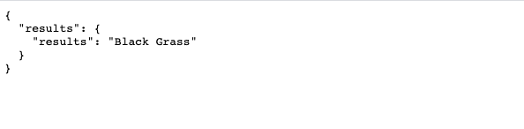
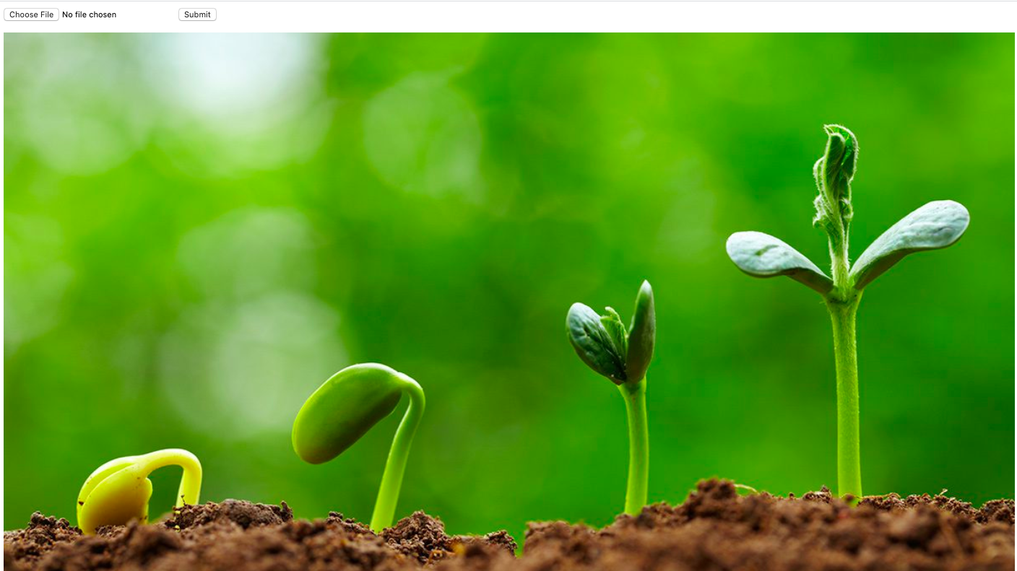
Visualization

Slide 19
Challenges:
In CNN, we faced a challenge with Translation variance:
By training the model with different translations like zoom, reverse, horizontal flip and vertical flip.
Background noise:
We have cleared the background using different stages of masking the image like: Blurring, converting to HSV, masking and creating a Boolean mask then removing the background completely.

Slide 20
Conclusion
Using a subset of the samples provided in the dataset of each species for training, we can achieve an accuracy.
Using all labeled data for training and making use of little data augmentation, we can obtain more accuracy on the validation set

Slide 21
Project Links
GitHub Link: https://github.com/hvbilla/Python-Deep-Learning-/blob/master/project/Project%20Increment1/plant-seedlings-classification.py
GitHub increment 1 wiki: https://github.com/hvbilla/Python-Deep-Learning-/wiki/Increment-1
GitHub increment 2 wiki :https://github.com/hvbilla/Python-Deep-Learning-/wiki/Increment-2

